Slide 1


Predicting Hostility Level Of Military Interstate Disputes
Classification in the Realm of Subjectivity
Elena Dubova

Slide 2


Project Introduction
Prediction Target
Level of hostility of Military Interstate Conflict
Motivation
Core topic in International Relations
Inevitability of conflicts
Few quantitative techniques applied in the field
Notes:
Basically, until we have states Conflicts are Natural, but we can Manage the Flow through different mechanisms.
That inflates subjectivity
Prevalence of Qualitative Approaches to Research in Political Science
That inflates subjectivity
Prediction of hostility level of future events can serve as decision making criteria in

Slide 3


Definition: Military Interstate Dispute
set of incidents grouped by location, issue and time involving the deliberate, overt, government-sanctioned,
and government-directed threat, display, or use of force between two or more states
86%
dyadic
Side A
Side B
Notes:
85.5% MIDs are strictly dyadic dyadic
Dyadic MIDs
Side A – dispute originator
Side B - target

Slide 4
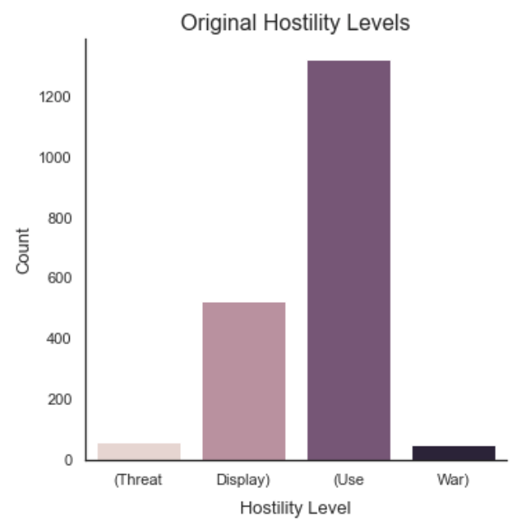
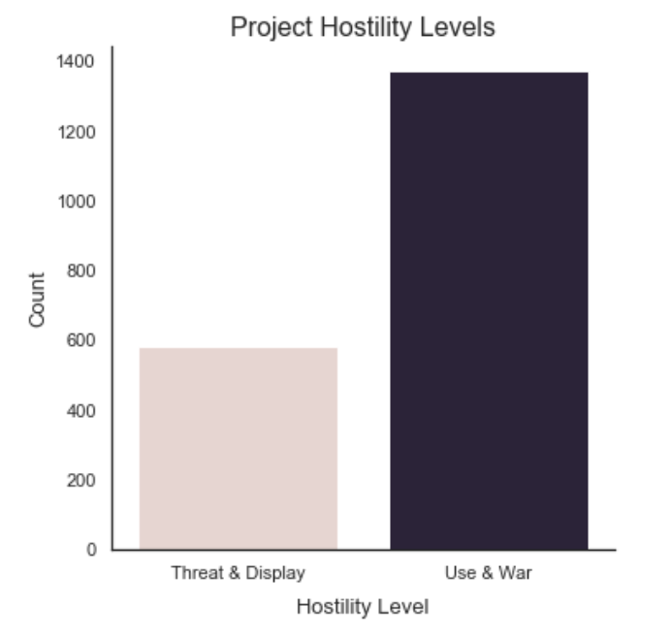
Definition: Hostility Level
Notes:
Ordinal
Multilevel
Imbalanced

Slide 5
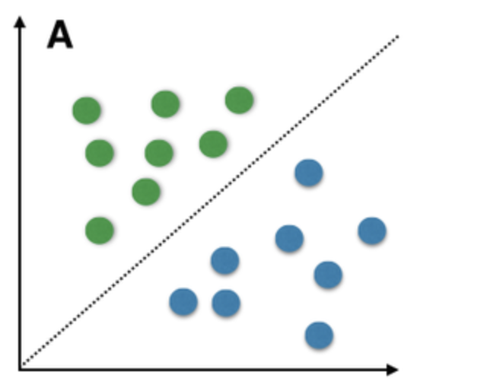



Project Setup
SQL
>
>
The Correlates of War. https://correlatesofwar.org
The World bank. https://www.worldbank.org

Slide 6
Conceptual Data Model
Incident
Incident
MID
MID
Participant
Incident
>
>
1816-2010
>
>
Macro
economic features
Incident Participant
s. 1960
Notes:
Hierarchy, cascade
Participants
Location
Issues
Inerval > 6 months
Limitations:
Using contemporary economic data as proxy to country economic state as detailed economic data is hard to find, sparse

Slide 7
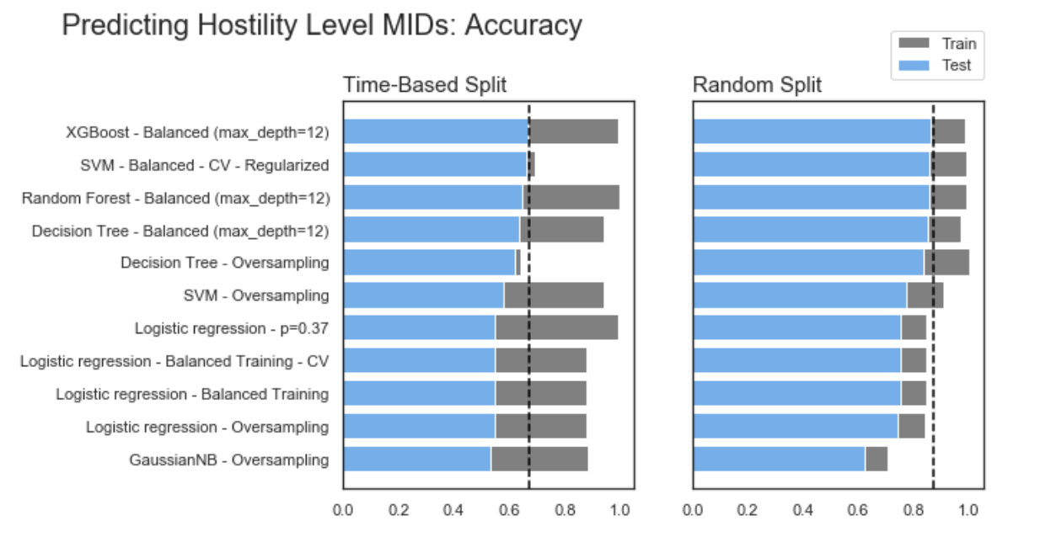
Results
67%
86%

Slide 8
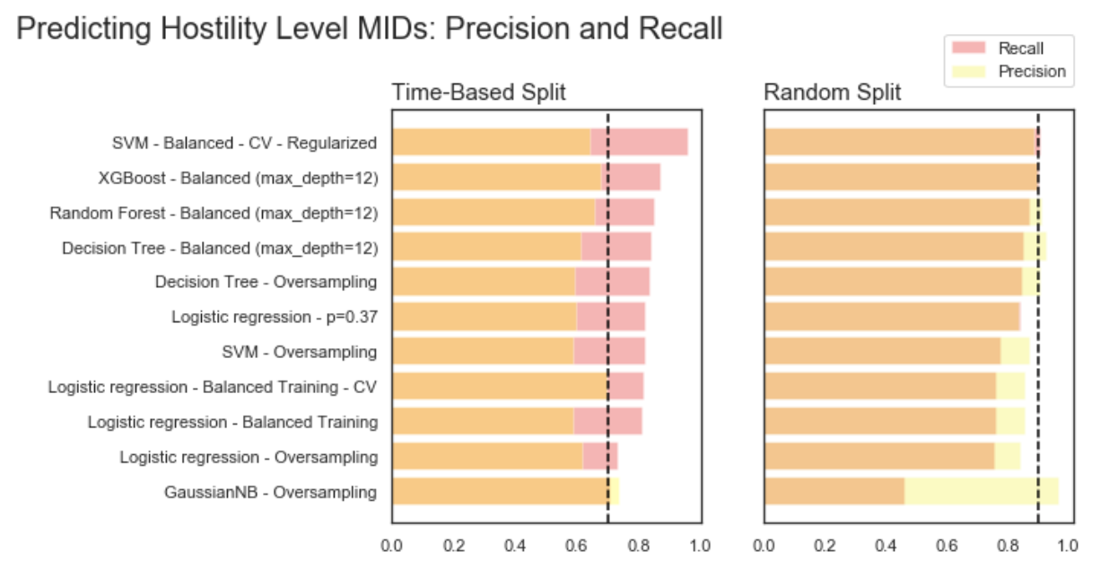
Results: Precision and Recall

Slide 9


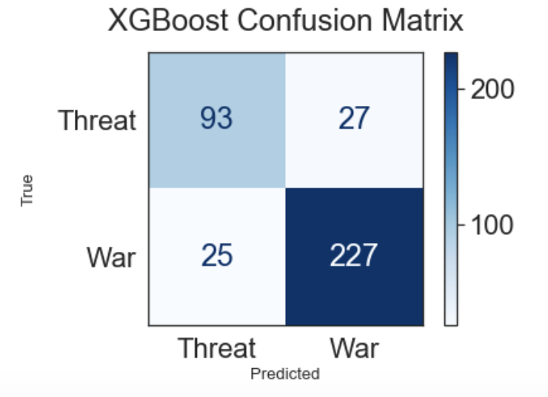


Results: Best Model
False Positive:
2004
False Negative:
2009
Generally:
Model tends to misclassify shorter MIDs
Notes:
Russian-Georgian Interstate Tensions in 2004 (surrounding history of Russian-Georgian conflicts over South Ossetia and Abkhazia
Taiwan protested Chinese Research vessels intrusion 2009 (triggered escalation around Matzu Masu islands ownership)

Slide 10
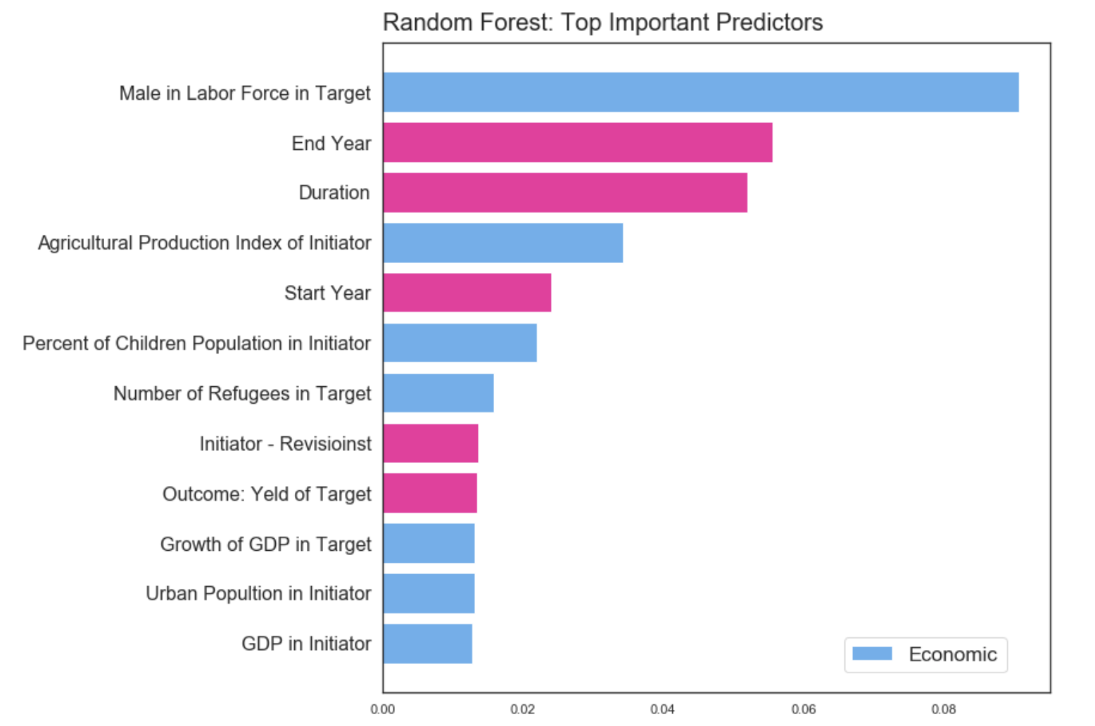
Inference: Important Predictors
Economic Data is Useful for Predictions
Population, GDP and Agricultural Index Stand Out as Predictors*
Non-economic factors are mostly time dependent

Slide 11
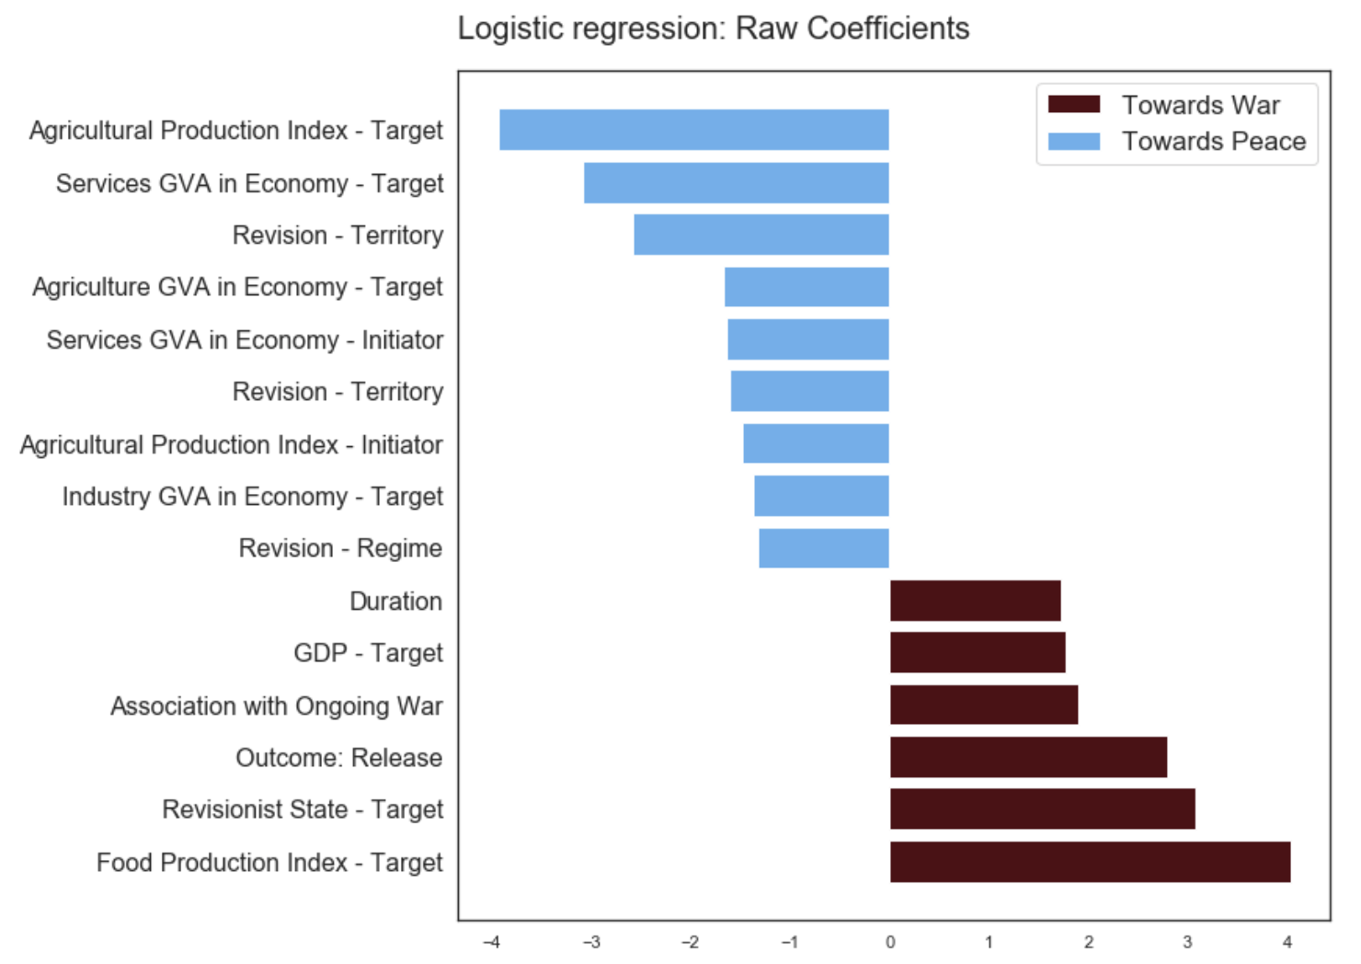
Inference: Important Predictors
Consistent role of Agricultural Index, Structure of GDP in decreasing hostility level
Time-based and politically-bound factors increase hostility level

Slide 12
Summary and Future Work
Key Points
Political science problems can be approached with quantitative techniques
Prediction of the future conflicts' characteristics require incorporating time-series analysis
Economic Indicators are meaningful predictors of MID level of hostility
Evolution of the conflicts towards application of efficient containing mechanisms
Future Work
Historical economic data to substitute contemporary ‘proxy’ data
Aggregate economic features that predict hostile intensions
Analysis on a participant and incident level
Notes:
Conclusion: conflicts evolve; and it is hard to predict future based on the past. Moreover, timed prediction is biased towards predicting a conflict when there is none. Imbalanced dataset. Secondly, because, conflicts from 1990 (bilateral to multilateral international relations are less intense in terms of usage of force and going to wAR.

Slide 13
Appendix

Slide 14
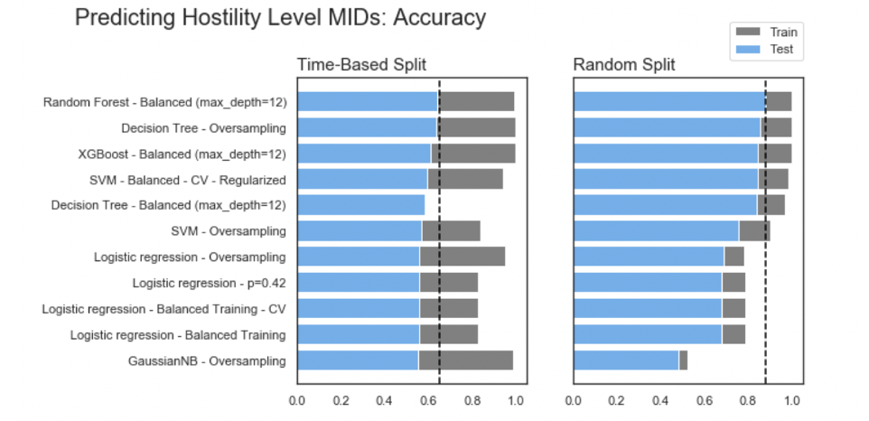
Reduced Model Results: Selected Features

Slide 15
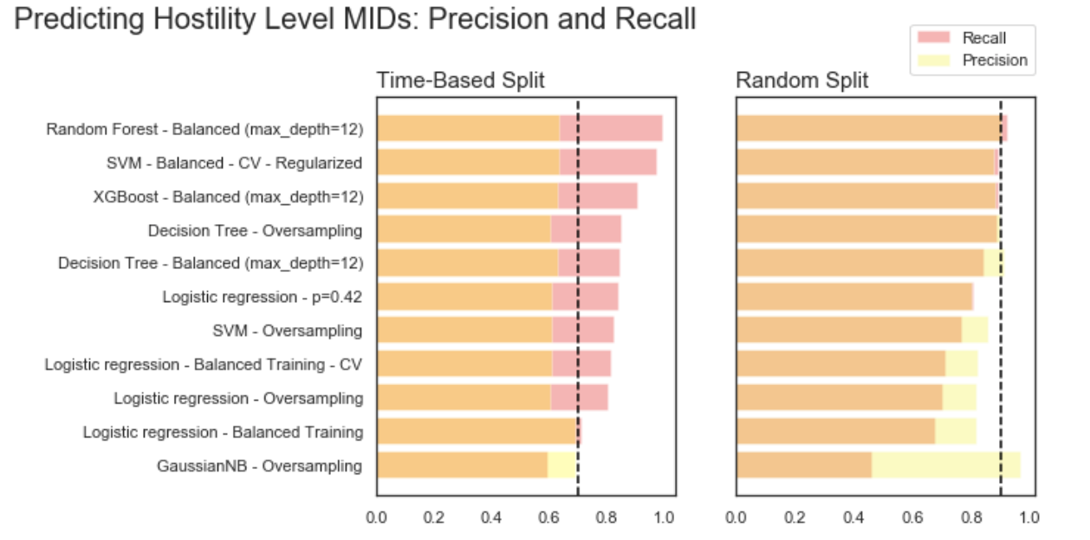
Reduced Model Results: Selected Features

